Slide 1
A Synthetic System That Senses Candida albicans and Inhibits Virulence Factors
Michael Tscherner, Tobias W. Giessen, Laura Markey, Carol A. Kumamoto, and Pamela A. Silver
Presented By: Yogindra Raghav and Matthew Eckelmeyer
Notes:
Explain Assertion-Evidence

Slide 2

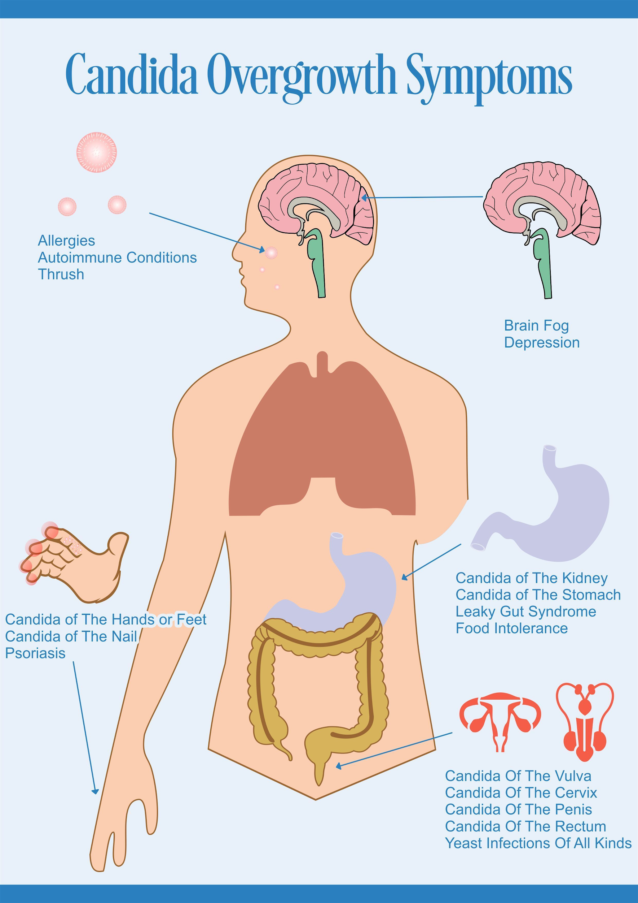
Candida Albicans Has Serious Health Implications
Notes:
Fungal Infections account for 1.5 million deaths
Candida infections have a 40% mortality rate in immunocompromised patients
Picture on left: **CUE ANIMATION** Highlight the white
Picture on right: Candida can grow in lots of places
**QUESTION**: What is the name of the common condition shown on the picture at the left? Oral thrush
Let’s now view Candida Albicans in its environment.

Slide 3
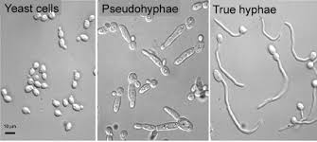
Candida Albicans Exhibits Morphological Plasticity
Images of hyphal form and yeast form
Notes:
**CUE ANIMATION** Yeast cells are what you think of when you think of a cell
Don’t worry about the pseudohyphae, it’s a transition period.
**CUE ANIMATION** True hyphae is long filamentous form of yeast cells. Hyphae is the same as the word “hypha” mentioned in the paper.
**ANECDOTE**: Have you ever opened an old, unsealed can of pasta sauce from your fridge and you find a white fungus? If you notice something interesting, the fungus looks like soft white balls with an infinite number of long spokes. This filamentous/spoke-like form is due to the fact that the fungus have assumed the hypha morphology.
We care about this morphological plasticity since it impacts human health as will be shown on the next slide.

Slide 4
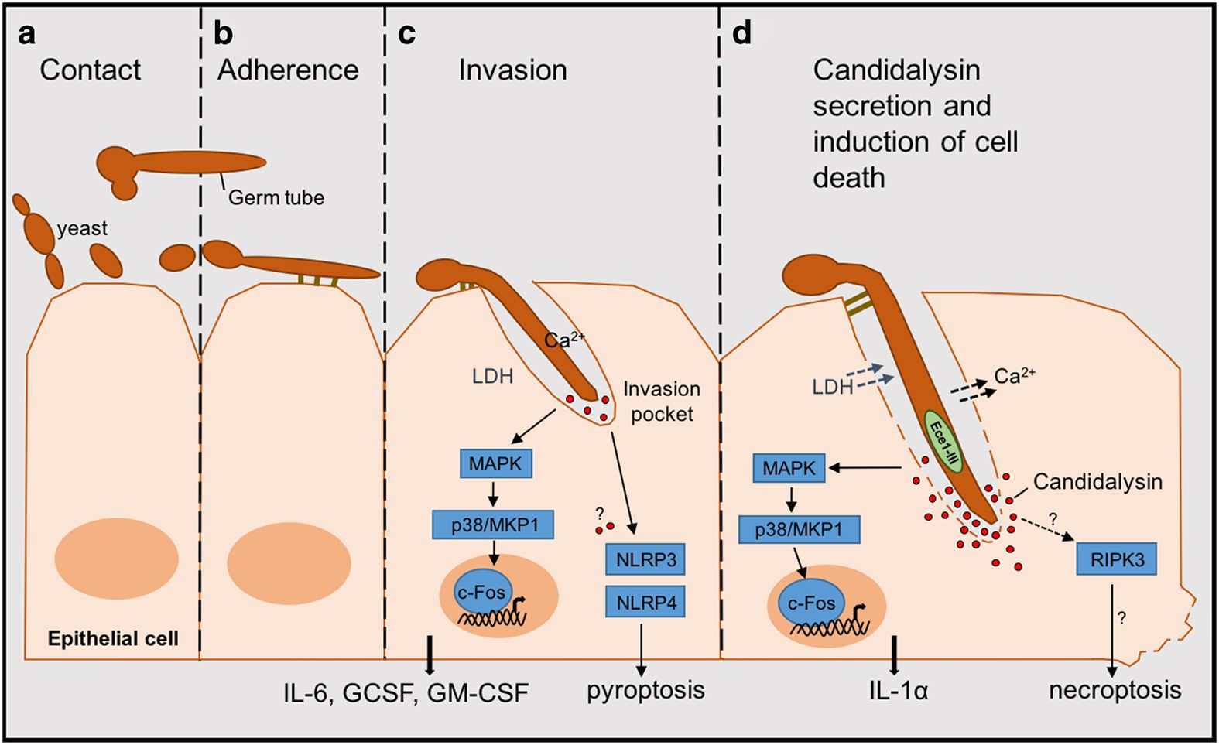
Hypha C. Albicans Causes Epithelial Cell Death
Notes:
**ANALOGY**: Once contact and adherence are made it’s almost like oil drilling. **CUE ANIMATION**The Hyphal form burrows itself into the epithelial cell and slowly breaks deeper into the barrier **CUE ANIMATION**
This ability is due to a peptide toxin known as Candidalysin which was discovered in 2016 and published in Nature.
It is created by Cell Elongation 1 Gene (ECE1) which will also be discussed in the next slide.
Let’s look in greater depth at what Candidalysin is.

Slide 5
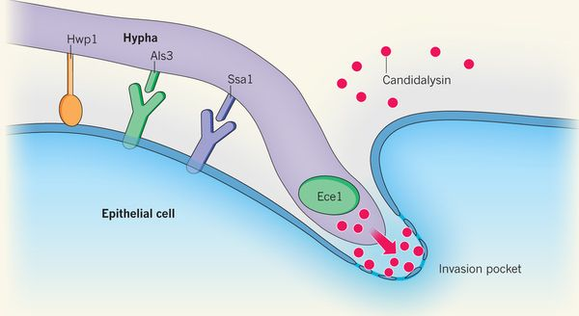
Candidalysin Causes Epithelial Cell Death
Notes:
Candidalysin is a 31 amino-acid alpha helical peptide.
It helps to destroy the membranes of epithelial cells.
**GO TO BACK BOARD AND DRAW SCHEMATIC**: ECE-1 is the “burrowing” factor that allows extension of hypha yeast celland is cut by Kex1 and Kex2 to make Candidalysin.
**QUESTION**: Is the hypha form of Candida Albicans dangerous to epithelial cells if it has a mutation that leads to the phenotype of not being able to produce Candidalysin? It is not dangerous. This was demonstrated in the paper that discovered this peptide.
With this background done, we can move onto the research that we read for today.

Slide 6
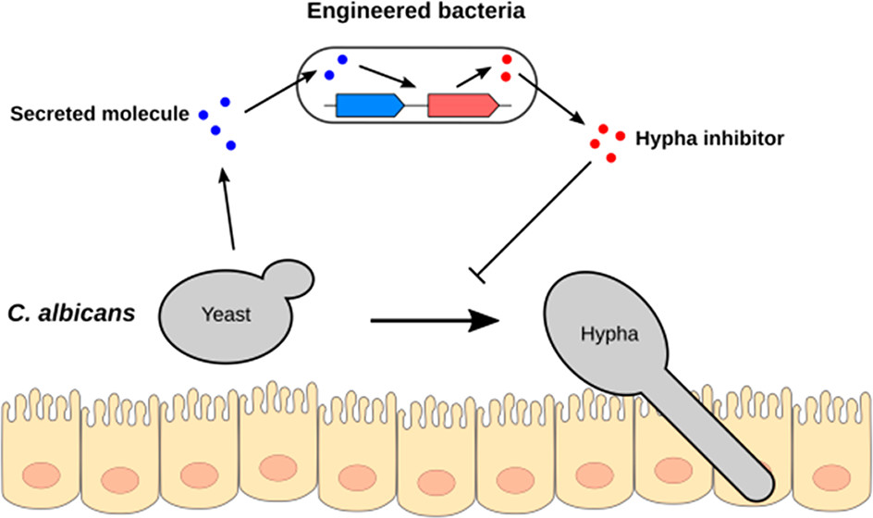
Synthetic E. coli Can Sense and Inhibit Yeast Hypha Formation
Notes:
General overview of the research goals
Let’s break down this graphic

Slide 7
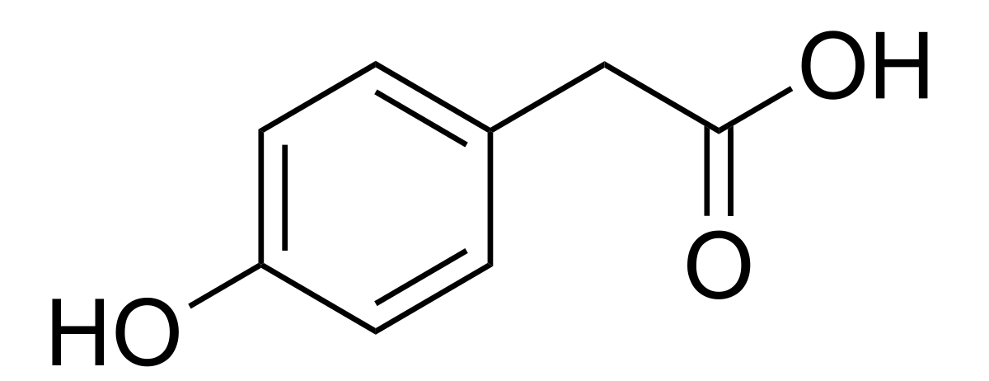
E. Coli (W) Uses 4-Hydroxyphenylacetic Acid (HPA) to Sense Presence of Candida Albicans
Notes:
Tyrosol is a quorum sensing molecule that the researchers initially cared about to use as a sensor.
They found out that instead C. Albicans actually makes another molecule **CUE ANIMATION** 4-Hydroxyphenylacetic Acid (HPA)
The important thing about this is that E. Coli W has a transporter for HPA and the import of this molecule can affect transcription. Matt will go into more details about this in a later part of this presentation\
**WRITE HPA ON BOARD**
**QUESTION**: What amino acid is this molecule most similar to? Tyrosine
The link between HPA and Tyrosine will be looked at soon.

Slide 8
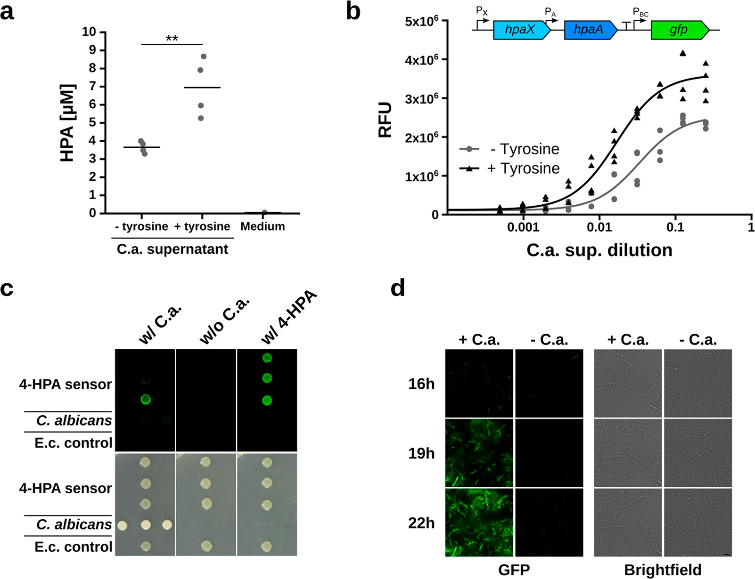
HPA is Produced in C. albicans and Increases With Tyrosine Supplementation
Notes:
Tyrosine supplementation increases HPA production
High-Performance Liquid Chromatography/Mass Spectrometry was used to determine HPA levels.
Reason for increase in HPA with tyrosine is due to the Ehrlich pathway.

Slide 9
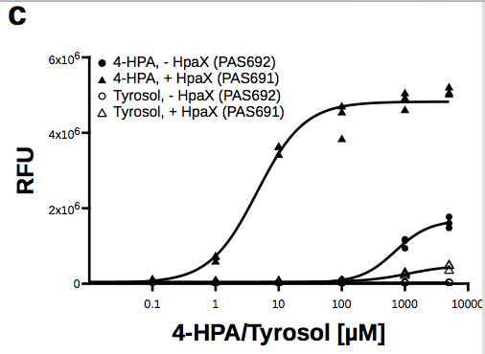
E. coli W HPA Transporter and Transcription Factor are Sufficient for Creation of HPA Sensor
Notes:
Strain used for this experiment is PAS691 which contains a plasmid with the same layout as what is above Figure “b” in this schematic
FIGURE B:
X-axis is amount of Candida Albicans in medium
Y-axis is Relative Fluorescent Units
This graph shows that the Sensor of this system works while also showing that it is even stronger when Candida Albicans has access to tyrosine.
FIGURE C:
Shows the importance of the HpaX protein product (which will be discussed soon).
Shows that this system works with HPA and not Tyrosol, so there is SPECIFICITY.

Slide 10
HPA Sensor Plasmid Exhibits Increased Fluorescence in Close Proximity to C. albicans
Notes:
FIGURE “C”:
This figure looks at the whole colony,
The distance is the key part of this figure.
Note the slightly green hue at the bottom of the second-most distant plasmid
Adding 4-HPA is used as a control.
FIGURE “D”:
You need Candida Albicans to actually be present for this to work.

Slide 11
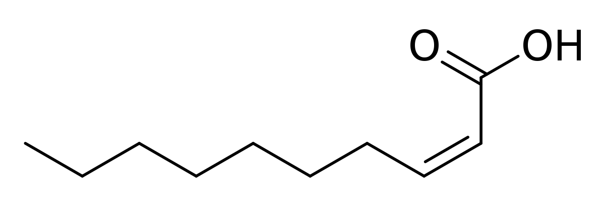
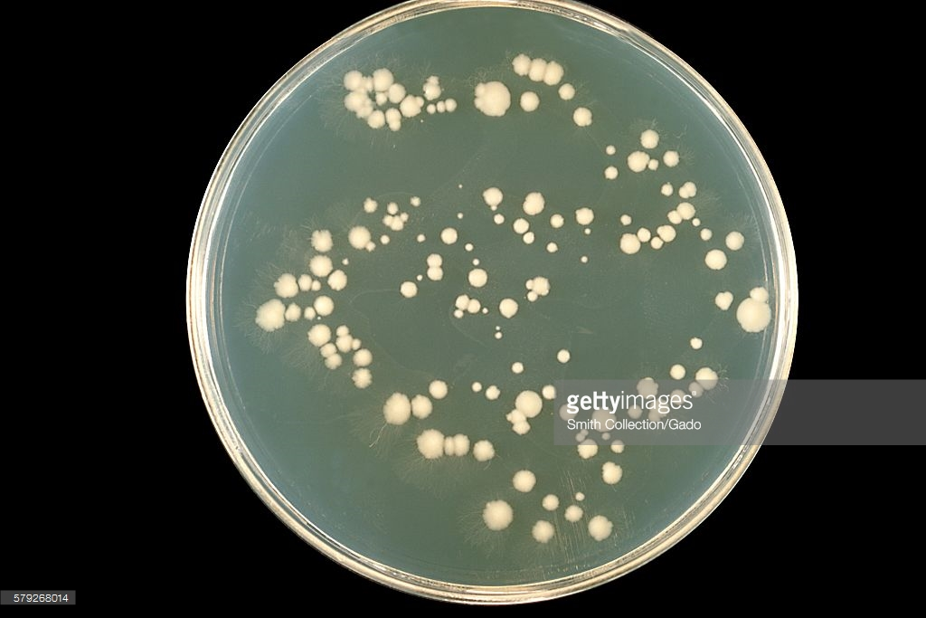
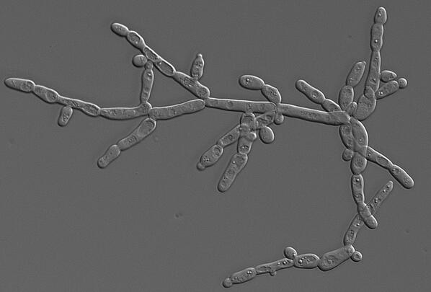
Cis-2-Dodecenoic Acid (BDSF) Inhibits Hypha Formation
Notes:
The molecule used for inhibition of hypha morphology is Cis-2-Dodecenoic (BDSF) . **CUE ANIMATION**
This molecule is known to be produced in the RpfF gene in a bacteria known as Burkholderia cenocepacia.
**WRITE BDSF ON BOARD**

Slide 12
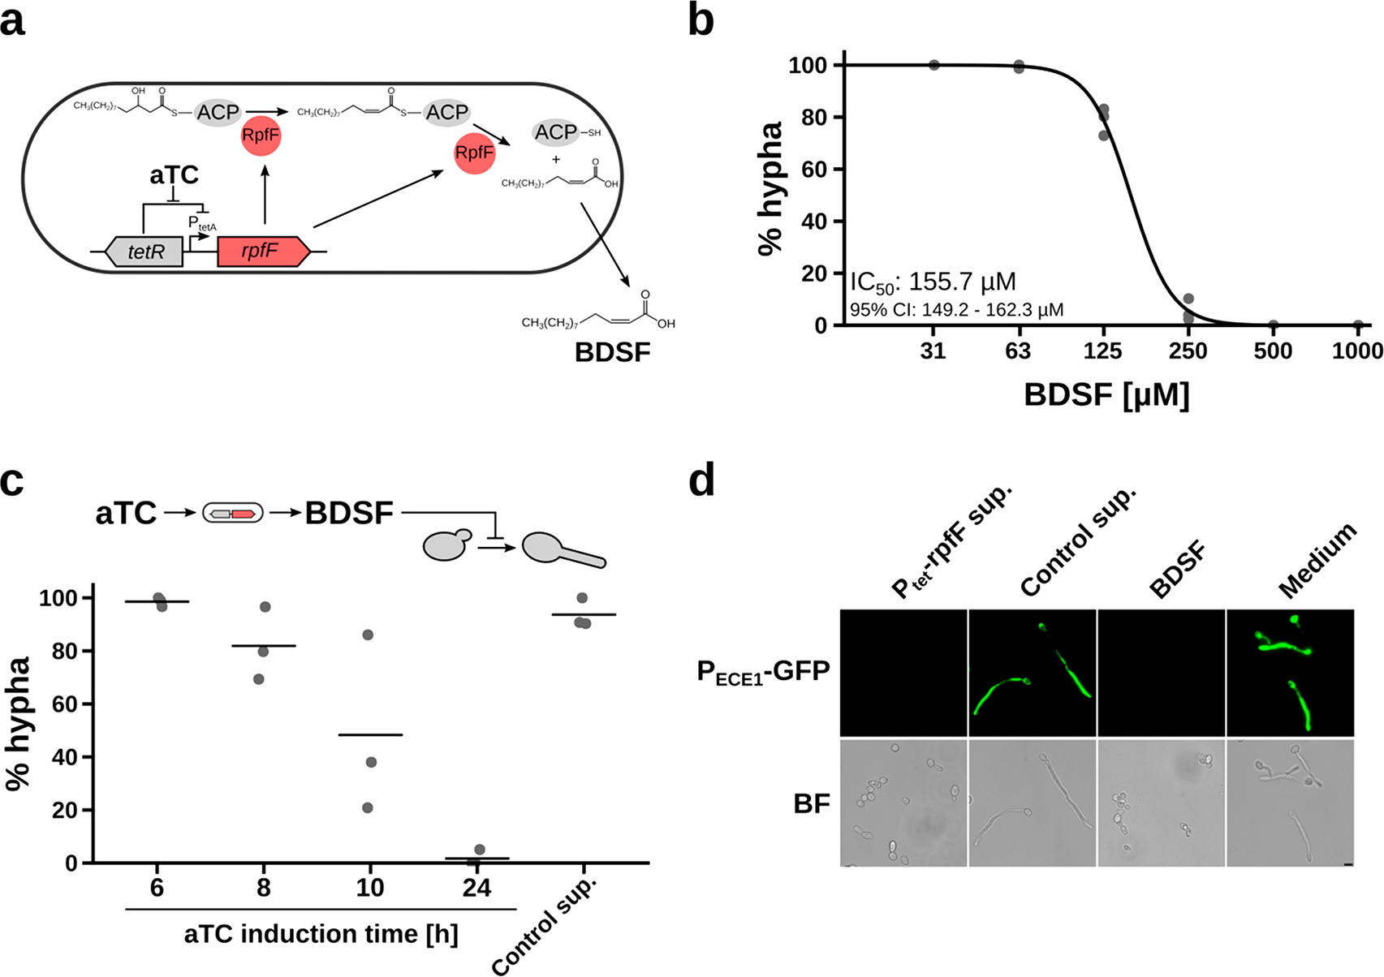
Expression of rpfF in E. coli Results in Production of Hypha Inhibitor
Notes:
RpfF produces enzyme with dehydratase and thioesterase activity.
The enzyme ultimately converts the 3-hydroxydodecanoic acid-acyl carrier protein complex into BDSF.
Talk about polyketides
**QUESTION**: The initial reactant is involved in a specific metabolic pathway. Based on the structure of the initial reactant as well as the presence of the acyl carrier protein, what pathway do you think this might be?
**CALL FOR INTERMISSION**

Slide 13
Expression of BDSF in E. coli is Sufficient to Inhibit Hypha Formation
Notes:
Start of Matt Slides
Figure B) C. albicans Yeast cells were exposed to hypha-inducing conditions (DMEM medium with 5% FBS at 37 degrees celsius)
In these conditions, we would expect to see 100% of all C. albicans convert to the hypha morphology, which is what they observed with 0 BDSF concentration
They also note the IC50 concentration for BDSF as 155.7 micromolar
Concentration at which half of the targets of an inhibitor have been inhibited
Figure C) Shows the induction time for the aTC inducible promoter for the rpff gene
From this, we can tell that there is a time window that must pass before BDSF concentration reaches a point where it can significantly affect C. albican’s morphology

Slide 14
BDSF Inhibition of Hypha Formation Reduces Expression of Virulence Factor Candidalysin
Notes:
Here they’re showing the effect that BDSF presence has on virulence factors
Again, Candidalysin is a toxin produced by the C. albicans which eats away at epithelial cell membranes, causing the organism to wedge itself in the membrane
They choose to tag the gene of Candidalysin’s precursor with GFP
This gene, as you can see here is ECE1
When they tested the GFP-tagged ECE1 gene in the presence of BDSF, there is no Candidalysin precursor
When they tested the GPF-tagged ECE1 gene in the presence of rpfF, which is the enzyme responsible for making BDSF, the same results are observed
In all other conditions, ECE1 is produced
In the Brightfield images, you can see that in the rpfF and BDSF suplemented samples all show C. albicans in its yeast morphology
In the control samples, which are producing Candidalysin, C. albicans is in Hypha morphology
This is another confirmation that BDSF is preventing hypha formation

Slide 15
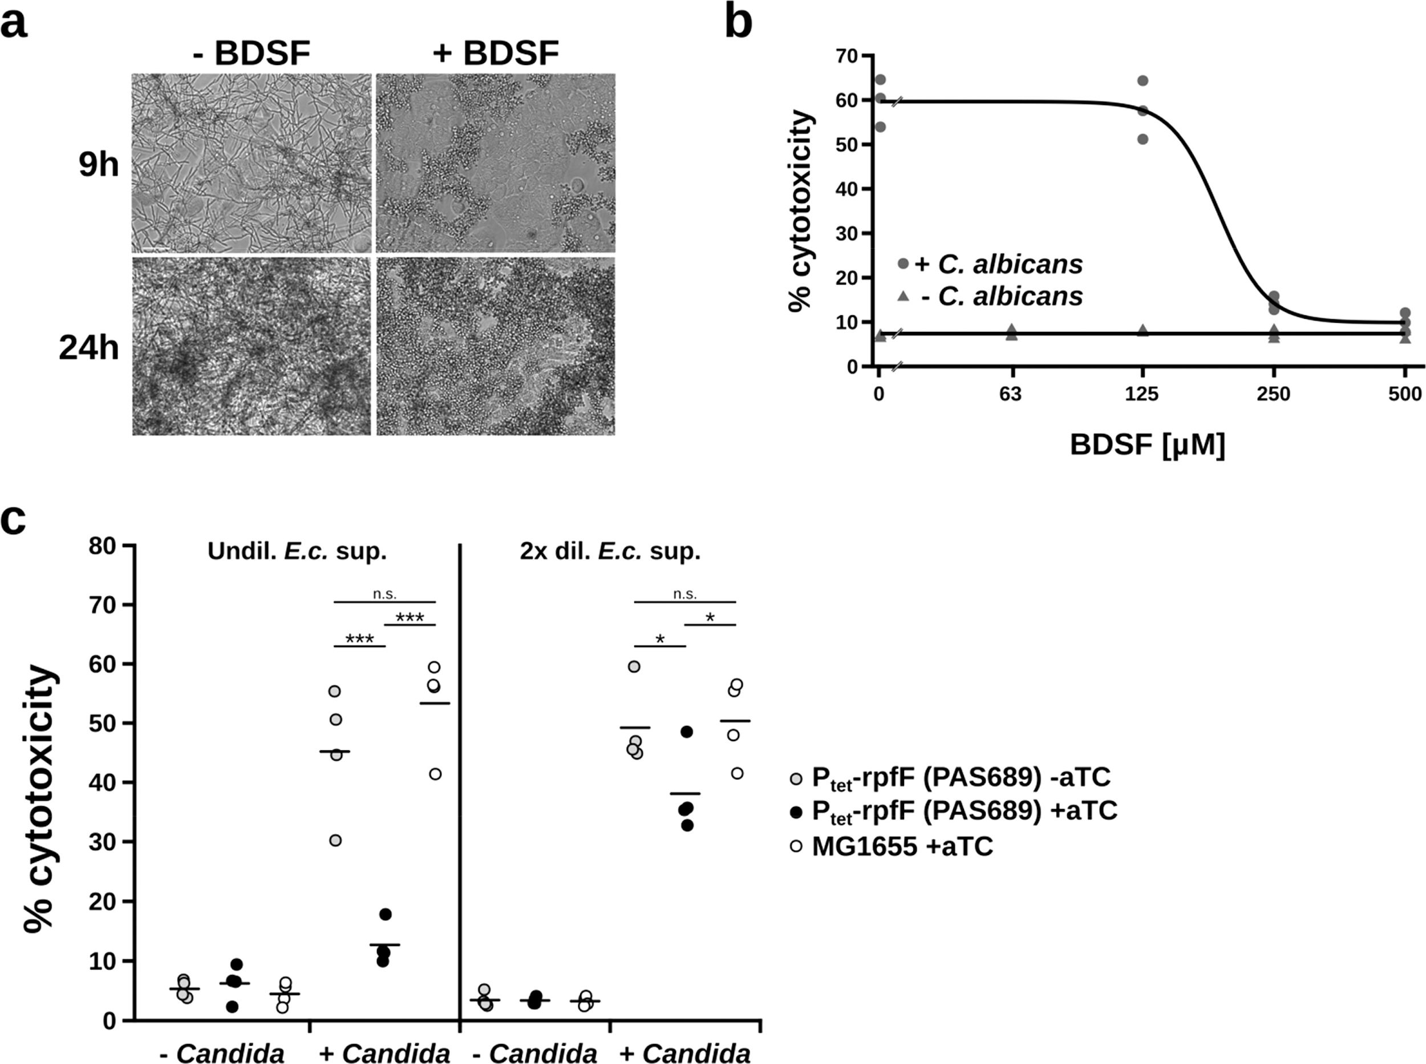
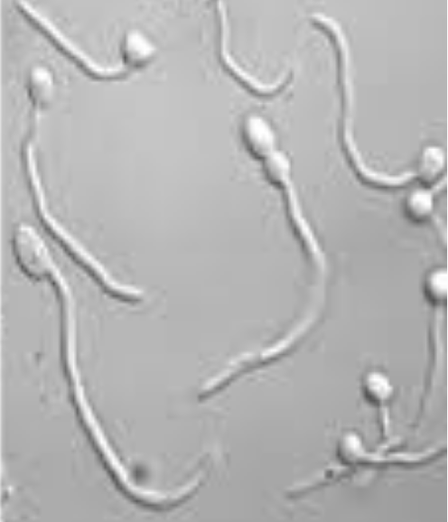
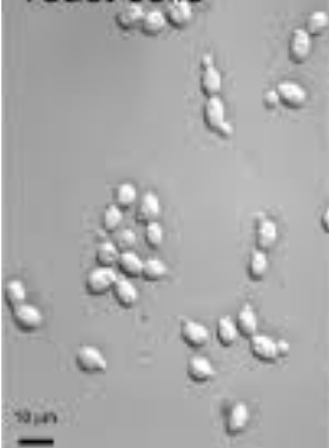
BDSF Production Prevents Attack of C. albicans Hypha on Caco-2 Epithelial Cells
Notes:
Reiterate that this is what hypha and yeast look like.
Without BDSF supplementation, C. albicans adopts a hypha morphology.
With BDSF inhibiting this transition, C. albicans adopts a yeast conformation.
Also talk about how the C. albican’s density is very high after 24 hours, so it is more difficult to distinguish morphology there

Slide 16
Increasing BDSF Supplementation Decreases Caco-2 Epithelial Cell Damage
Notes:
Here they are looking at the damage that C. albicans does to Caco-2 epithelial cells
They used a CytoTox 96 assay which measures LDH concentration, which is a cytosolic enzyme that is only released upon cell lysis
Effectively they are measuring the percent of Epithelial cells that are lysed
The triangles here show epithelial cell cytotoxicity in the absence of C. albicans, which of course is very small. The curve with circles on it shows the cytotoxicity in the presence of C. albicans, which is initially quite high, but decreases as BDSF concentration is increased.

Slide 17
C. albicans Induces Caco-2 Epithelial Cell Damage
Notes:
In this figure, they are confirming that the increase in Epithelial cell lysis is due to the presence of C. albicans, and not some other toxin.
When supplemented with aTC, their engineered system is able to produce rpfF, and subsequently, BDSF, which is shown by the black dots
In their undiluted sample, this BDSF production drops cytotoxicity to about 15%
In their 2x dilution sample, it only drops cytotoxicity to 40%, but this is still reduced damage when compared to their samples without BDSF

Slide 18
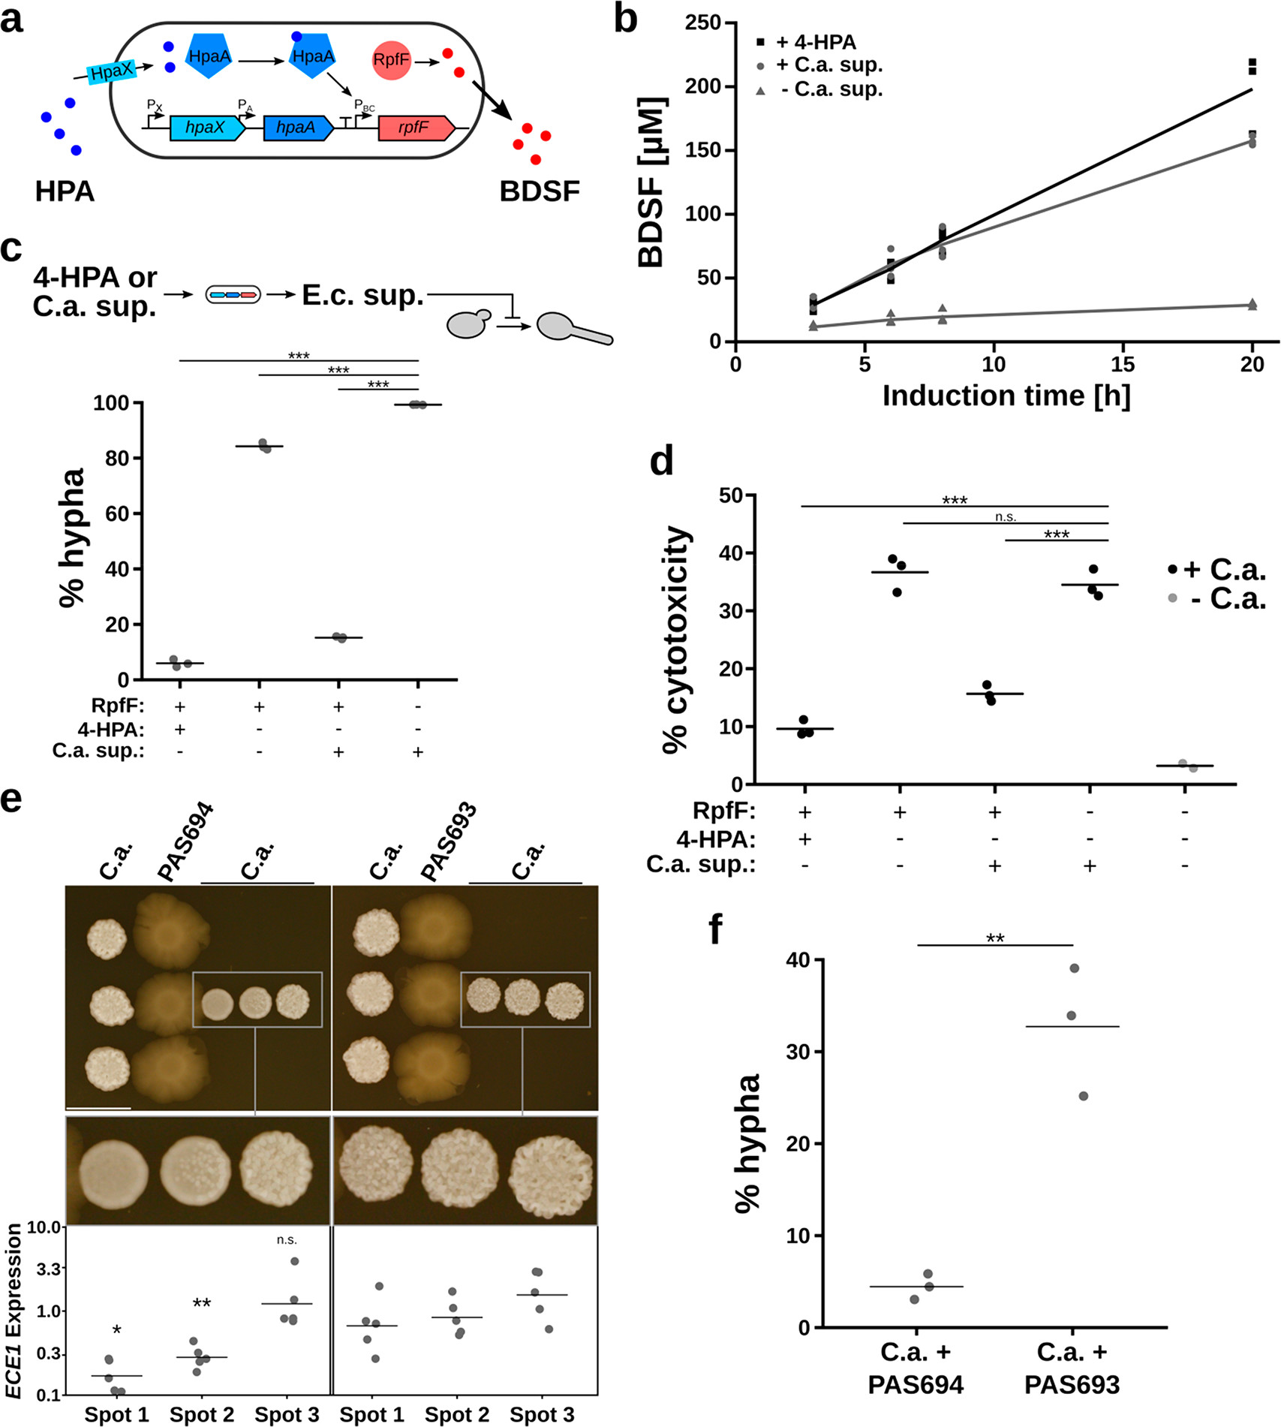

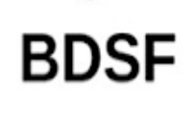
E. Coli Can Be Engineered to Combine HPA Sensor and rpfF Plasmid
Enzyme that produces BDSF
HPA Transcription Factor
HPA Transporter
HPA Transporter Gene
HPA Transcription Factor Gene
Gene that produces RpfF enzyme
Notes:
Ask question/remind audience of HPA and BDSF.
“Sense-and-Respond” system

Slide 19
Induction With HPA Stimulates Production of BDSF in Mouse E. Coli Strain NGF-1
Notes:
This figure is showing the increase in production of BDSF from E. coli with the sense-and respond system, over a period of 20 hours
The top line shows the BDSF production when the E. coli is supplemented with 4-HPA, this results in the greatest production of BDSF, as expected
The middle line shows production of BDSF when the engineered E. coli are in the presence of C. albicans
The bottom line shows the production of BDSF from a medium of E. coli only

Slide 20
Sense-and-Respond System Decreases C. albicans-Mediated Damage of Mouse Epithelial Cells
Notes:
This figure shows C. albicans cytotoxicity to Epithelial cells under 5 different conditions
The functional Sense-and-respond system decreases Epithelial cell damage in all cases
Cell damage is decreased especially in the cases where RpfF, HPA, or both are supplemented to the medium

Slide 21
Sense-and-Respond System Causes Significant Reduction in Hypha Formation vs. Control
Notes:
This figure shows two strains of E. coli with the Sense-and-respond system
PAS693 has a knocked-out rpfF gene, preventing the formation of BDSF
PAS694 has a fully-functional sense-and-respond system
The functional system is able to reduce hypha formation to around 5%, where as the system without BDSF has about 35% of C. albicans in hypha formation

Slide 22
The Functional System Reduces Expression of Virulence Factor Candidalysin
Notes:
Again, 694 contains the functional sense-and-response system and 693 contains the inactive system
The left-most columns of C. albicans were grown before E. coli were introduced to allow for sufficient production of HPA
After sufficient production, engineered E. coli were introduced to the plate
After adding these E. coli, the rightmost column of C. albicans was added to the plate
In the functional system we can see a sharp decrease in hypha formation in the C. albicans in close proximity to the 694 colonies
This becomes less pronounced in colonies further away from 694
As expected, 693 has no effect on morphology of the added C. albicans
They also examined the ECE1 expression for each of these 3 added colonies
ECE1 expression is very low in the colonies close to the functional system, and is high in all other colonies
Look at first paragraph page 438 to explain figure better

Slide 23
Journal Club Discussion Points
Why is targeting virulence factors potentially better than using antifungals? You can avoid “superbug” resistance strains.
Is HPA actually unique molecule secreted by C. albicans? What does this mean for specificity?
Made by humans and plants
What is the purpose of lactate dehydrogenase? How could it be used to measure cell lysis?
Converts pyruvate to lactate and is generally abundant. Converts NAD+ to NADH and H+ which then the H+ can react to form a red color with enzyme in colorimetric assay
What is the most common disease caused by C. albicans infection?
Candidemia
What other important E. coli strain contains a HPA transporter?
E. coli HS (Human strain)
Could such a system prevent conditions like oral thrush?
No. This only inhibits hyphal formation. This does not control the existence and abundance of yeast.
What other organisms could be inhibited using this system?
Pseudomonas aeruginosa
Notes:
ONLY use these points if journal club discussion starts to die down.

Slide 24
Figure 1

Slide 25
Figure 2

Slide 26
Figure 3

Slide 27
Figure 4

Slide 28
Figure 5

Slide 29
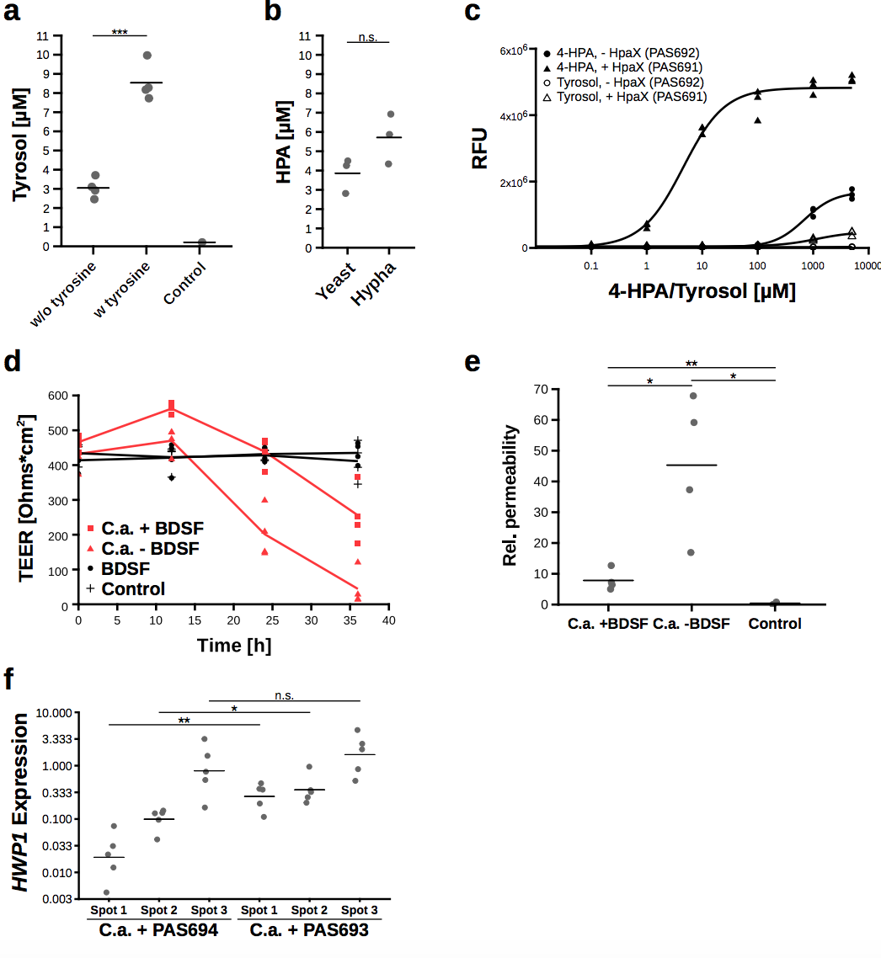
Figure 1S

